Slide 1
Survival Analysis using R

Slide 2
Survival Topics
Survival Analysis concepts
Common survival analysis techniques
Presenting results
Both theory and practice
  Definitions
  censoring
  Kaplan-Meier
  Log-rank
  Cox proportional hazards
  R statistical software (open source: http://cran.r-project.org/)

Slide 3
Introduction to survival analysis
Survival Analysis is referred to statistical methods for analyzing survival/ time to event data
Events could be
  Recurrence of disease, death etc
Examples
  Time between surgery and relapse
Data is usually censored
  Example-study ends before all the patients dies

Slide 4
Objective of survival analysis
Estimate probability that an individual surpasses some time-to-event for a group of individuals.
Compare time-to-event between two or more groups.
Assess the relationship of covariates to time-to-event.

Slide 5
Types of survival data
When the time of event is known, then we have complete information e.g. rat number 4 died on 3rd day. This is called uncensored data
When the occurrences of the event are not known then we have incomplete information e.g. those rats who escaped. This is called censored data
Follow-up time, calculated from
    exit time when the outcome is experienced, or last-seen time
    entry time when individual enters study

Slide 6
Two reasons for censoring
During investigation we have incomplete information due to LOSS TO FOLLOW UP
When the investigation has come to an end and the experimental units are still alive. This is censoring due to WITHDRAWAL ALIVE

Slide 7
Forms/ Types of censoring
Right censoring
Left censoring
Type I censoring
Type II censoring
Random censoring
Interval censoring
Informative and non-informative censoring
  Most common is right censored

Slide 8
Censoring
How could we account for censoring?
  Ignore it and say event occurred at time of censoring
    Incorrect because this is almost certainly not true
  Remove patient from analysis
    Potential bias and loss of power
  Survival analysis
The objective is to estimate the survival distribution of patients in the presence of censoring

Slide 9
Functions describing survival times
T is a random variable representing survival time - Can be described by a probability distribution
  Cumulative distribution function
  Survival function
  Probability density function
  Hazard function
  Cumulative hazard function

Slide 10
Functions of T
Let T denote the survival time
  t ≡ a specific point in time.
1. Survival function
Survival function: probability survival time is greater than a specific value S(t)=P(T>t)
Ŝ(t)=number of patients surviving longer than t
total number of patients in the study

Slide 11
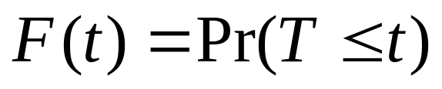
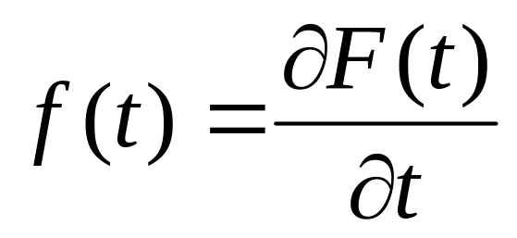
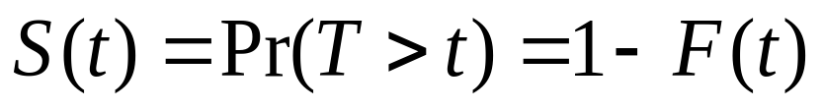
Mathematical Definitions
Distribution function
Density function
Survival function

Slide 12
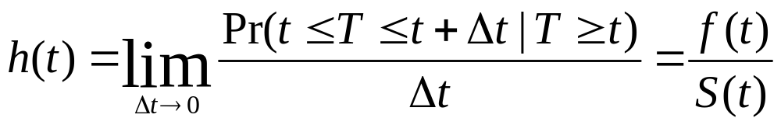
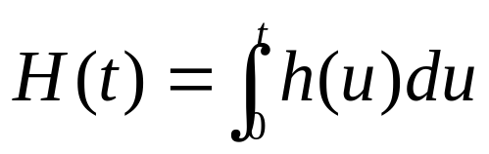
Mathematical Definitions
Hazard function:
Cumulative hazard:

Slide 13
Statistical Inference
Has two components
  Estimation of survival function
  Testing of hypothesis of survival functions
There are two methods of approaching them
  Parametric approach
  Non parametric approach
A combination of the 2 approaches gives the regression (i.e. estimation and testing of the hypothesis)

Slide 14
KAPLAN-MEIER ESTIMATOR

Slide 15
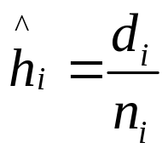
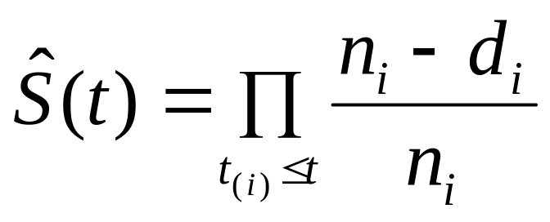
Kaplan-Meier Estimate of S(t)
Kaplan-Meier estimator of survival is a nonparametric method of inference concerning the survivor function S = Pr(T > t).
Rank the survival times as t₍₁₎≤t₍₂₎≤…≤t_{(n)}.
Number of individuals at risk before t_{(i)} ≡ n_{i}
Number of individuals with failure time t_{(i)} ≡ d_{i}
Estimated hazard function at t_{(i)}:
Formula

Slide 16
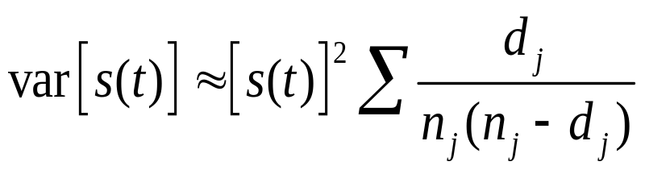
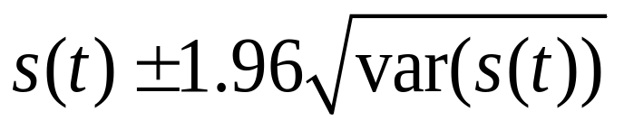
Kaplan-Meier Estimate of S(t)
And the 95 % CI is given by

Slide 17
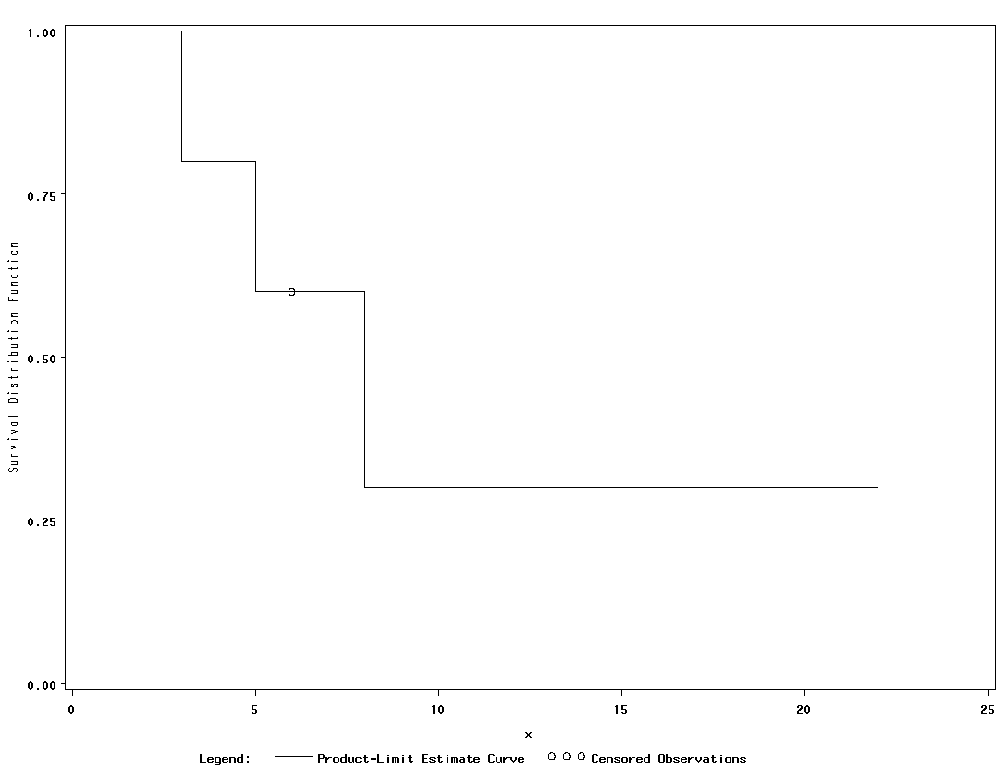
Kaplan-Meier Curve

Slide 18
Functions of interest in R
Survival object: Surv
Kaplan-Meier estimates: survﬁt
The log-rank test: survdiff
The Cox proportional hazards model: coxph
The Accelerated failure time model: survreg
Relevant R packages: survival, survcomp, HMISC, Design, MASS

Slide 19
Example
Event = time to relapse
Data:
  10, 20+, 35, 40+, 50+, 55, 70+, 71+, 80, 90+
Before complex functions may be performed, the data has to be put into the proper format: a survival object
In R we use Surv(time, status)
time is a vector of event time, and status is a vector of indicator (denoting if the event was observed or censored)

Slide 20
R codes for Kaplan-Meier
library(survival)
time <- c(10,20,35,40,50,55,70,71,80,90)
status <- c(1,0,1,0,0,1,0,0,1,0)
data=cbind(t,d)
survobj <- with(data,Surv(time,status))
st
fit <- survfit(survobj~1, data=data)
fit
summary(fit)
attributes(fit)
plot(fit.km, xlab="time to relapse (months)", ylab="Survival Function", yscale=100, main="Survival Distribution", conf.int = 0.95)

Slide 21
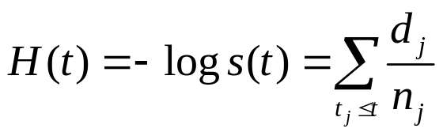
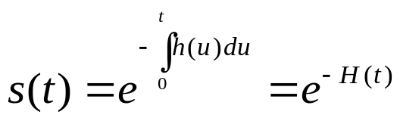
Aalen-Nelson Estimate of S(t)
Uses the cumulative hazard function
In R, to estimate S(t), using output from survfit()
< survobj <- Surv(time, status)
< fit1 <- summary(survfit(survobj~1))
< S.hat <- fit1$surv
< H.hat <- −log(S.hat)
a<- survfit(coxph(Surv(time,status)~1), type="aalen")
summary(a)
basehaz(coxph(Surv(time,status)~1,data=data))

Slide 22
LOG-RANK TEST

Slide 23
LOG-RANK TEST
Use the Log-Rank Test to compare the survival functions of two samples/ treatment groups.
H0: The two survival functions are the equivalent
Ha: The two survival functions are different
Goal: Test whether two groups differ in population survival functions.

Slide 24
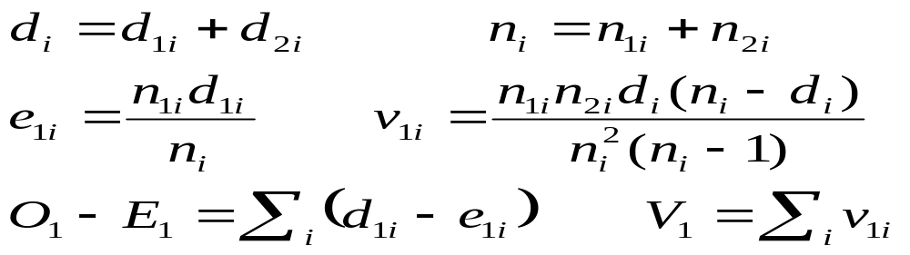
Log-Rank Test
Notation:
  t_{(i)} ≡ Time of the i^{th} failure time (across groups)
  d_{1i} ≡ Number of failures for trt 1 at time t_{(i)}
  d_{2i} ≡ Number of failures for trt 2 at time t_{(i)}
  n_{1i} ≡ Number at risk prior for trt 1 prior to time t_{(i)}
  n_{2i} ≡ Number at risk prior for trt 2 prior to time t_{(i)}
Computations:

Slide 25
R codes
> survdiff(formula, rho=0)
formula is a survival object against a categorical covariate variable.
rho is a scalar parameter that controls the type of test.
With default rho=0, this is the log-rank or Mantel-Haenszel test.
With rho=1, it is equivalent to the Peto and Peto modiﬁcation of the Gehan-Wilcoxon test.
>survdiff(survobj~status, rho=0)

Slide 26
Cox Proportional Hazard Model

Slide 27
Cox Proportional Hazard Model
CPHM is a technique for investigating the relationship between survival time and independent variables
The most popular model for survival analysis:
Goal: Compare two or more groups (treatments), adjusting for other risk factors on survival times (like Multiple regression)
p explanatory variables (including dummy variables)

Slide 28
Cox regression for time to event
useful when incidence rates vary over time
hazards in both exposed and unexposed are allowed to vary but their ratio is assumed to be constant – this is the proportional hazards assumption. Thus the Cox model are also known as the proportional hazards model
Cox model is fitted by creating risk sets of individuals still at risk at the time of each failure

Slide 29

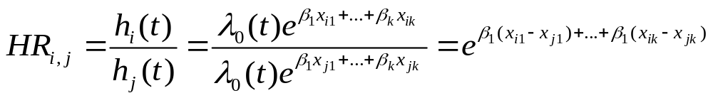
Cox Proportional Hazard Model
The semi-parametric model given by
is the baseline hazard function. This is the function when all the covariates equal to zero
The hazard ratio is independent of time t.
This defines the “proportional hazards property”.

Slide 30
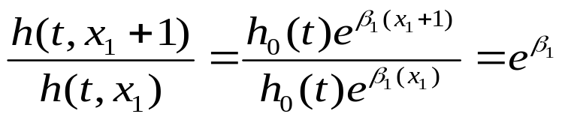

Interpretation of the Betas
We need to find the ratio where there is a unit increase in the covariates provided other covariates stay fixed
We interprete as the unit increase in log hazard per unit increase of x
(just as log-odds in logistic regression)

Slide 31
R example
> coxph(formula, method)
formula is linear model with a survival object as the response variable
method is used to specify how to handle ties. The default is ‘efron’. Other options are ‘breslow’ and ‘exact’.
> cox.fit < −coxph(Surv(time, status) x+y+z, method =‘breslow)
to obtain the baseline survival function
> my.survfit.object < −survfit(coxph.fit)

